Slide 1
Intro to SEO - Travel Agency

Slide 2
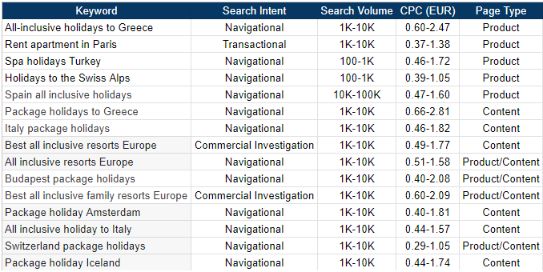
Seed keyword: All-inclusive trips around Europe
5 services/locations. 10 content pages ideas
We can assume that our hypothetical travel agency is small, that’s why our keywords have such low search volume, yet we keep up with our goal of CPC under 3 EUR

Slide 3
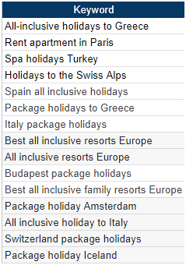
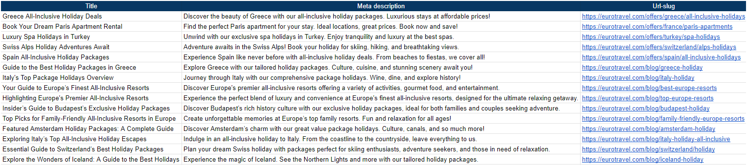
I tried to match some of the meta descriptions with CTA like “Discover” “Find” and etc. Since it’s a travel agency and we don’t need a specific CTA like “buy” “get now” it feels more welcoming
We left Eastern Europe out of the possible destinations as it’s not the most attracting part of Europe for tourists looking for all-inclusive holidays

Slide 4
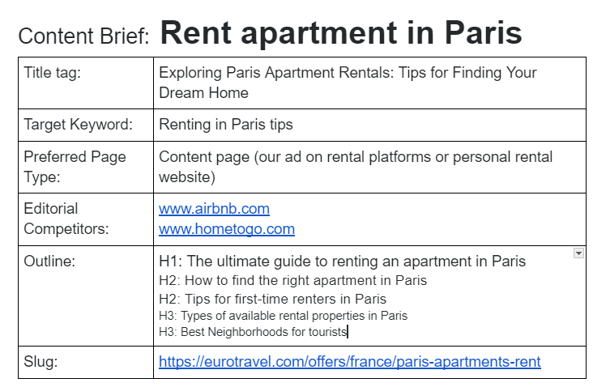

Slide 5
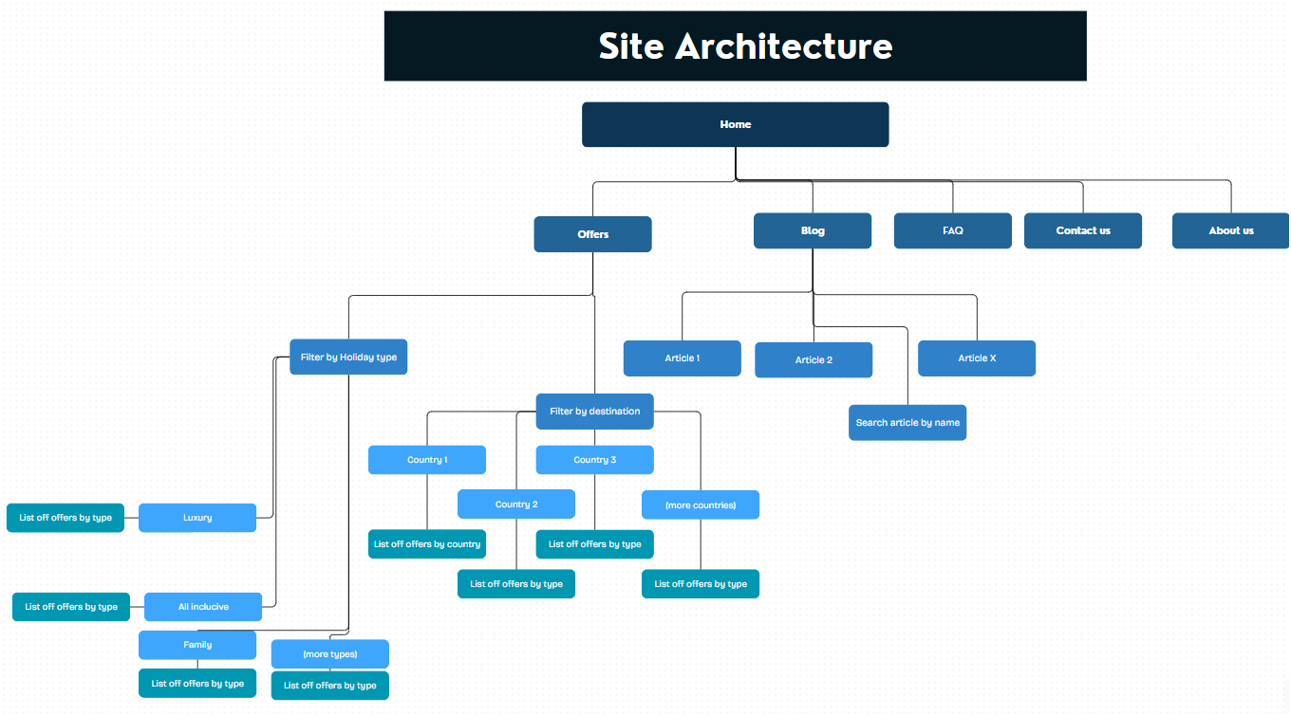

Slide 6
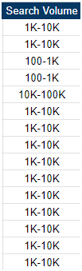
Expected revenue from this plan
GIVEN NUMBERS ARE HYPOTHETICAL AND UNREALISTIC
Given that we have a search volume with a range, we’ll take the average volumes and summed it up we have 116 000 searchers per month.
CTR - 10% Conversion rate - 5% AOV - 1000 EUR
116 000 * 0,1 * 0,05 * 1000= 580 000 EUR
If we were to calculate profit, we would take average CPC into consideration. 1,12 EUR is average CPC, so our spend would be:
116 000 * 0,1 * 1,12 = 12 992 EUR , leaving us with ~ 567 000 EUR gross profit
We have to keep in mind that 10 of our pages are content pages where people are less likely to convert compared to product pages, so the revenue and profit calculated here is hypothetical. We need information what’s the conversion rate on our blog pages, this way we can see what’s working or not and scale accordingly. If I had to guess, I’d say less than 0,5% convert from blog pages, compared to given conversion rate of 5%.

